Slide 1
Netflix Database management system
Presented by – manikanta
Institute – it vedant
Guided by – samaranjanachary sir (faculty, it vedant)

Slide 2
introduction
Netflix is a leading online streaming platform offering movies, series, and documentaries globally.
This project demonstrates how a relational SQL database can efficiently manage Netflix's data including users, movies, subscriptions, and views.

Slide 3
PROJECT OBJECTIVE
Design a relational SQL database for Netflix
Manage users, plans, subscriptions, movies, genres, and ratings
Track user activity and views
Extract insights using SQL queries

Slide 4
PROJECT SCOPE
User registration and subscription tracking
Movie and genre management
Viewing history tracking
Rating and analytics
Payment and revenue tracking
TOOLS USED
MySQL Workbench
PowerPoint for documentation

Slide 5
Database Overview
Database: Netflix_db
Tables:
1. Users
2. Plans
3. Subscriptions
4. Movies
5. Genres
6. Movie Genres
7. Views
8. Ratings

Slide 6
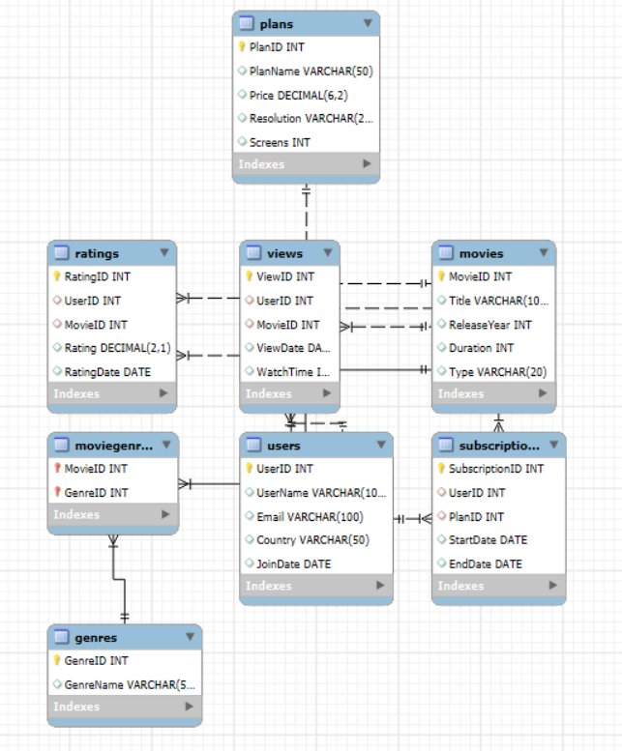
ER Diagram
The ER diagram shows relationships among the tables:
Users → Subscriptions (1-to-Many)
Plans → Subscriptions (1-to-Many)
Movies → Movie Genres (Many-to-Many)
Users → Views (1-to-Many)
Movies → Views (1-to-Many)
Users → Ratings (1-to-Many)
Movies → Ratings (1-to-Many)

Slide 7
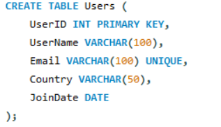
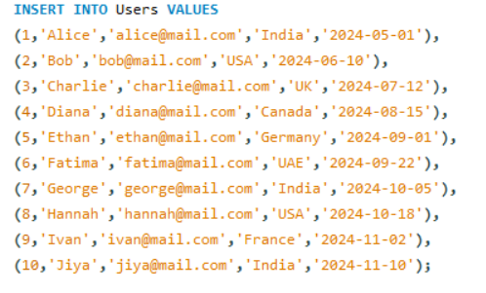
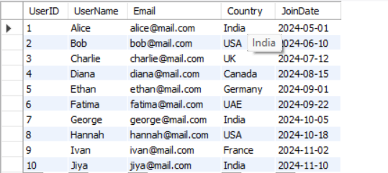
Users Table:
Stores registered users’ information.
Fields: User ID, User Name, Email, Country, Join Date
Primary Key: User ID
Constraints: Email must be unique

Slide 8


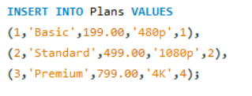
Plans Table:
Stores Netflix subscription plans.
Fields: Plan ID, Plan Name, Price, Resolution, Screens
Primary Key: Plan ID

Slide 9
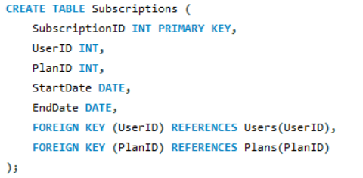
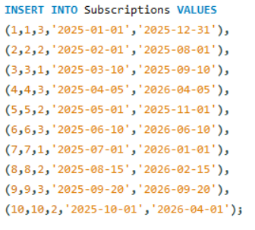
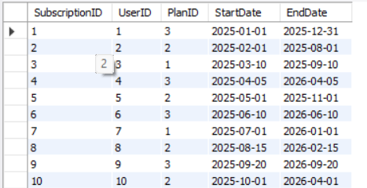
Subscriptions Table:
Links a user with a subscription plan.
Fields: Subscription ID, User ID, Plan ID, StartDate, End Date
Foreign Keys: User ID → Users(User ID), Plan ID → Plans(Plan ID)

Slide 10
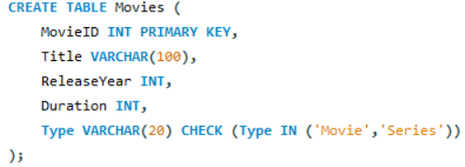
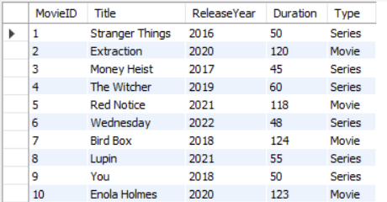
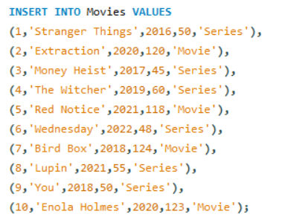
Movies Table:
Contains all movies and series.
Fields: Movie ID, Title, Release Year, Duration, Type
Constraints: Type must be ‘Movie’ or ‘Series’

Slide 11
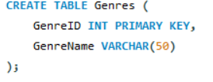
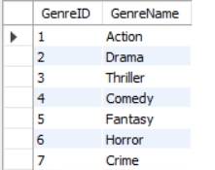
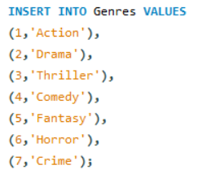
Genres Table:
Stores movie genres.
Fields: Genre ID, Genre Name
Primary Key: Genre ID

Slide 12
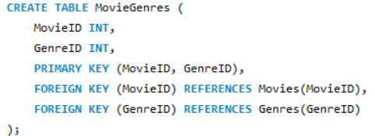
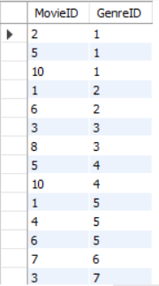
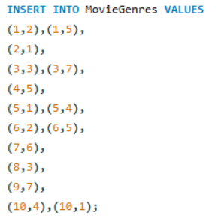
Movie Genres Table:
Many-to-Many table linking movies with genres.
Fields: Movie ID, Genre ID
Primary Key: (Movie ID, Genre ID)
Foreign Keys: Movie ID → Movies(Movie ID), Genre ID → Genres(Genre ID)

Slide 13
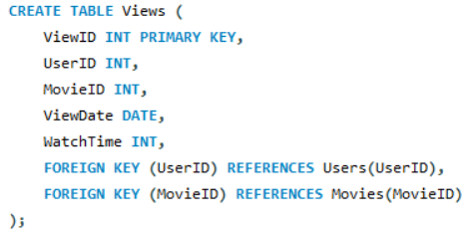
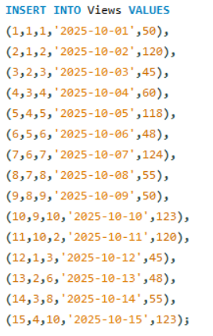
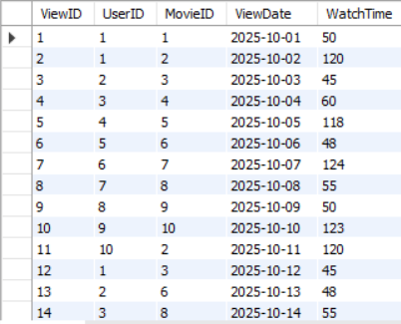
Views Table
Tracks movies watched by users.
Fields: View ID, User ID, Movie ID, View Date, Watch Time
Foreign Keys: User ID → Users(User ID), Movie ID → Movies(Movie ID)

Slide 14
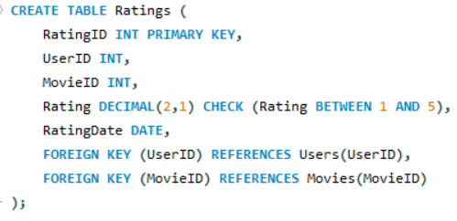
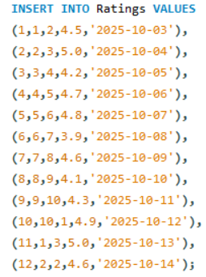
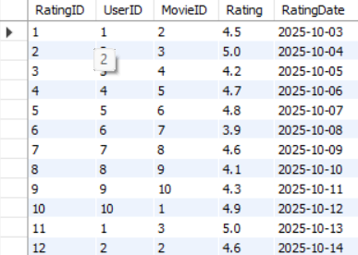
Ratings Table
Stores user ratings for movies.
Fields: Rating ID, User ID, Movie ID, Rating, Rating Date
Constraints: Rating between 1 and 5
Foreign Keys: User ID → Users(User ID), Movie ID → Movies(Movie ID)

Slide 15

Problem Statement:
1) Find users from a specific country, e.g., India.
SELECT * FROM Users WHERE Country='India’;

Slide 16

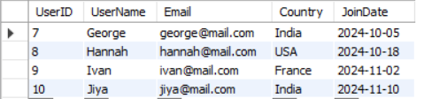
3) Count total number of users.
SELECT COUNT(*) AS TotalUsers FROM Users;
4) Find users who joined after 1st October 2024
SELECT * FROM Users WHERE JoinDate > '2024-10-01';

Slide 17
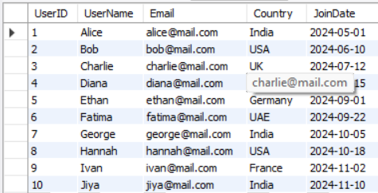

5)Users with Gmail email
SELECT * FROM Users WHERE Email LIKE '%mail.com';
6)Count users per plan
SELECT PlanID, COUNT(*) AS UsersCount FROM Subscriptions GROUP BY PlanID;

Slide 18
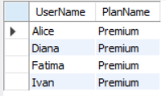
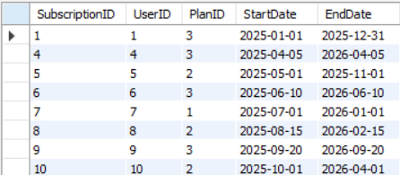
7)Users in Premium plan
SELECT u.UserName, p.PlanName
FROM Users u
INNER JOIN Subscriptions s ON u.UserID = s.UserID
INNER JOIN Plans p ON s.PlanID = p.PlanID
WHERE p.PlanName='Premium';
8)Active subscriptions today
SELECT * FROM Subscriptions WHERE CURDATE() BETWEEN StartDate AND EndDate;

Slide 19

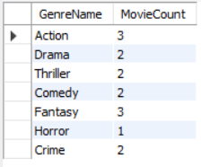
9)Count movies per type
SELECT Type, COUNT(*) AS Total FROM Movies GROUP BY Type;
10)Count movies per genre
SELECT g.GenreName, COUNT(*) AS MovieCount
FROM MovieGenres mg
INNER JOIN Genres g ON mg.GenreID=g.GenreID
GROUP BY g.GenreName;

Slide 20

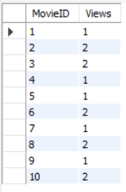
11)Movies of Fantasy genre
SELECT m.Title
FROM Movies m
INNER JOIN MovieGenres mg ON m.MovieID = mg.MovieID
WHERE mg.GenreID=5;
12)Total views per movie
SELECT MovieID, COUNT(*) AS Views FROM Views GROUP BY MovieID;

Slide 21

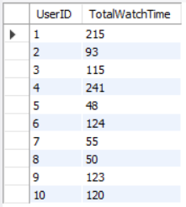
13)Movies watched by Alice
SELECT m.Title
FROM Views v
INNER JOIN Users u ON v.UserID=u.UserID
INNER JOIN Movies m ON v.MovieID=m.MovieID
WHERE u.UserName='Alice’;
14)Total watch time per user
SELECT UserID, SUM(WatchTime) AS TotalWatchTime
FROM Views
GROUP BY UserID;

Slide 22


15)Users who watched more than 2 movies
SELECT UserID, COUNT(*) AS MovieCount FROM Views GROUP BY UserID HAVING COUNT(*)>2;
16)Most-watched movie
SELECT MovieID, COUNT(*) AS Views FROM Views GROUP BY MovieID ORDER BY Views DESC LIMIT 1;

Slide 23

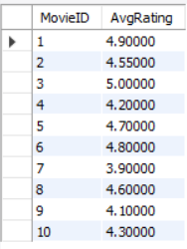
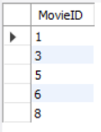
17)Average rating of all movies
SELECT AVG(Rating) AS AvgRating FROM Ratings;
18)Average rating per movie
SELECT MovieID, AVG(Rating) AS AvgRating FROM Ratings
GROUP BY MovieID;
19)Movies with above-average rating
SELECT MovieID FROM Ratings GROUP BY MovieID HAVING AVG(Rating) > (SELECT AVG(Rating) FROM Ratings);

Slide 24


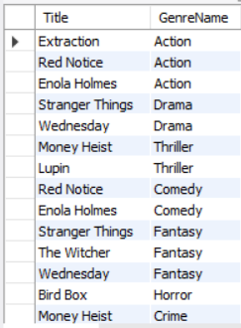
20)Highest-rated movie
SELECT MovieID, AVG(Rating) AS AvgRating FROM Ratings
GROUP BY MovieID ORDER BY AvgRating DESC LIMIT 1;
21)Users who gave 5-star rating
SELECT UserID, MovieID FROM Ratings WHERE Rating=5;
22)Movies and their genres
SELECT m.Title, g.GenreName
FROM Movies m
INNER JOIN MovieGenres mg ON m.MovieID = mg.MovieID
INNER JOIN Genres g ON mg.GenreID = g.GenreID;

Slide 25
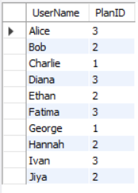
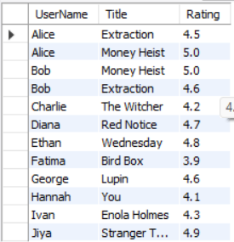
23)Users and their subscriptions
SELECT u.UserName, s.PlanID
FROM Users u
INNER JOIN Subscriptions s ON u.UserID = s.UserID;
24)Movies watched by a user with rating
SELECT u.UserName, m.Title, r.Rating
FROM Users u
INNER JOIN Ratings r ON u.UserID=r.UserID
INNER JOIN Movies m ON r.MovieID=m.MovieID;

Slide 26


25)Movies never watched
SELECT m.Title
FROM Movies m
LEFT JOIN Views v ON m.MovieID = v.MovieID
WHERE v.ViewID IS NULL;
26)Movies never rated
SELECT m.Title
FROM Movies m
LEFT JOIN Ratings r ON m.MovieID = r.MovieID
WHERE r.RatingID IS NULL;

Slide 27
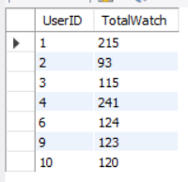
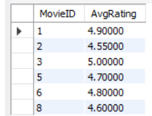
27)Users with total watch time above average
SELECT UserID, SUM(WatchTime) AS TotalWatch
FROM Views
GROUP BY UserID
HAVING SUM(WatchTime) > (SELECT AVG(WatchTime) FROM Views);
28)Movies with average rating above 4.5
SELECT MovieID, AVG(Rating) AS AvgRating
FROM Ratings
GROUP BY MovieID
HAVING AVG(Rating) > 4.5;

Slide 28
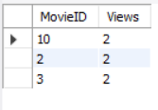
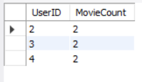
29)Top 3 movies by views
SELECT MovieID, COUNT(*) AS Views
FROM Views
GROUP BY MovieID
ORDER BY Views DESC
LIMIT 3;
30)Users who watched exactly 2 movies
SELECT UserID, COUNT(*) AS MovieCount
FROM Views
GROUP BY UserID
HAVING COUNT(*) = 2;

Slide 29
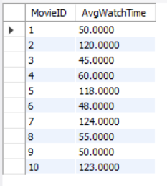

32)Average watch time per movie
SELECT MovieID, AVG(WatchTime) AS AvgWatchTime
FROM Views
GROUP BY MovieID;
33)Users who rated more than 1 movie
SELECT UserID, COUNT(*) AS RatingsCount
FROM Ratings
GROUP BY UserID
HAVING COUNT(*) > 1;

Slide 30
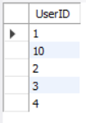

34)Users who watched but didn’t rate a movie
SELECT DISTINCT v.UserID
FROM Views v
LEFT JOIN Ratings r ON v.UserID = r.UserID
AND v.MovieID = r.MovieID
WHERE r.RatingID IS NULL;
35)Movies watched by at least 3 users
SELECT MovieID
FROM Views
GROUP BY MovieID
HAVING COUNT(DISTINCT UserID) >= 3;

Slide 31

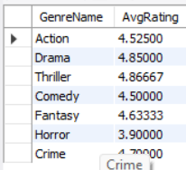
36)Top 2 users by total watch time
SELECT UserID, SUM(WatchTime) AS TotalTime
FROM Views
GROUP BY UserID
ORDER BY TotalTime DESC
LIMIT 2;
37)Average rating per genre
SELECT g.GenreName, AVG(r.Rating) AS AvgRating
FROM Ratings r
INNER JOIN Movies m ON r.MovieID = m.MovieID
INNER JOIN MovieGenres mg ON m.MovieID = mg.MovieID
INNER JOIN Genres g ON mg.GenreID = g.GenreID
GROUP BY g.GenreName;

Slide 32
Conclusion
The Netflix Database Management System efficiently handles user, movie, and subscription data.
Using SQL queries, valuable insights like revenue trends and viewing patterns can be obtained.
Future Scope: Integrating AI-based recommendation systems.

